Slide 1

HW10 - RPart
Ryan Coslove rmc326

Slide 2
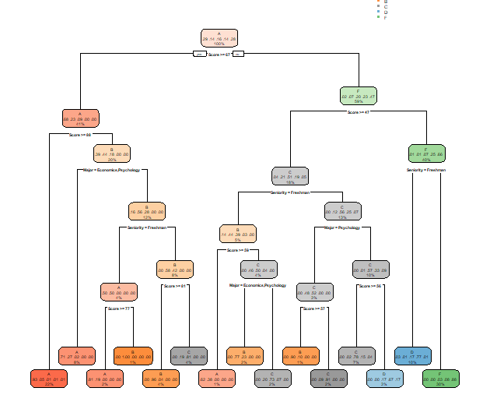
Rpart results without control

Slide 3
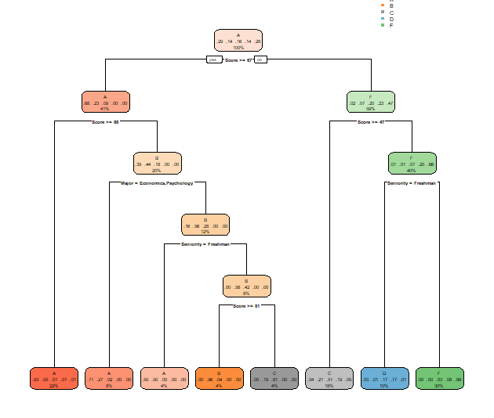
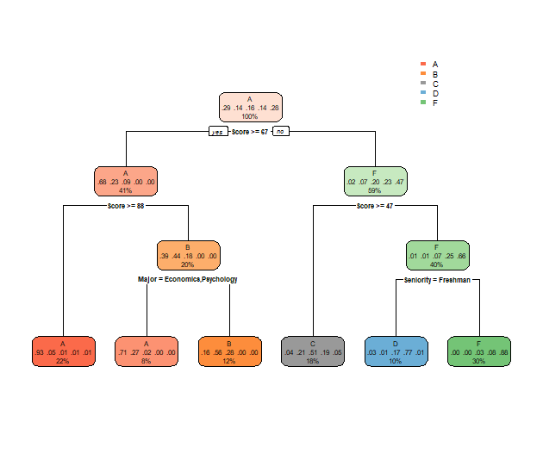
Using Controls
These are the different rpart graphs I tested with different controls
This slide and the next contain a total of 4 of my test cases

Slide 4
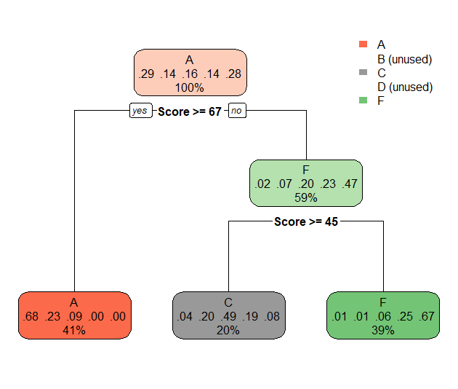

Using Controls Continued
These are the different rpart graphs I tested with different controls
This slide and the previous contain a total of 4 of my test cases

Slide 5
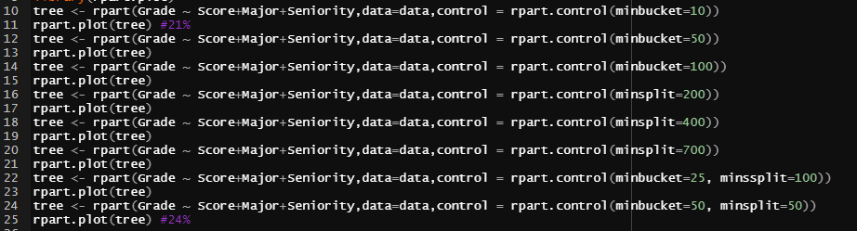
Varied Controlled rparts
Tried various combinations of minbucket and minsplit values
Increasing the minbucket made the tree more generalized but the accuracy of the subsets suffered as a result.

Slide 6
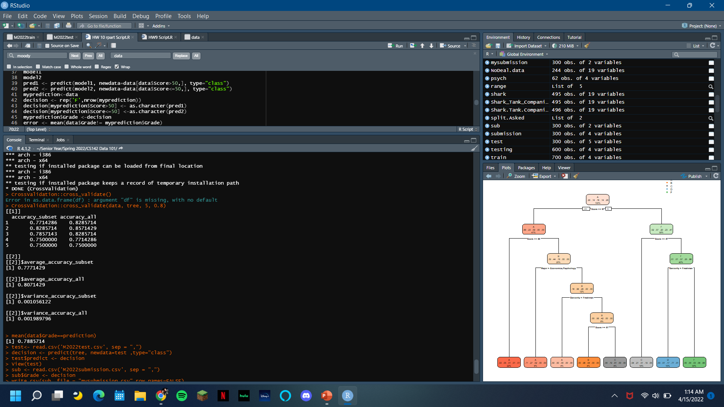
Cross Validation
My best rpart was tree <- rpart(Grade ~ Score+Major+Seniority,data=data,control = rpart.control(minbucket=10))
The accuracy was around the 78% I found form my mean prediction mean(data$Grade==prediction)

